Slide 1
DBL Embedded Systems
A sorting machine to sort black and white discs
Group 16
Presenters: Phung D.T. (Dat), Keet M. (Maarten) and Petrescu T. (Tudor)

Slide 2
Subjects
Machine Design
Specification
Priorities
Design Decisions
Software Specification
Software Design

Slide 3
Machine Design
Specification
Priorities
Reliability
Speed
Robustness
Accessibility
Space
Building difficulty
Amount of parts

Slide 4
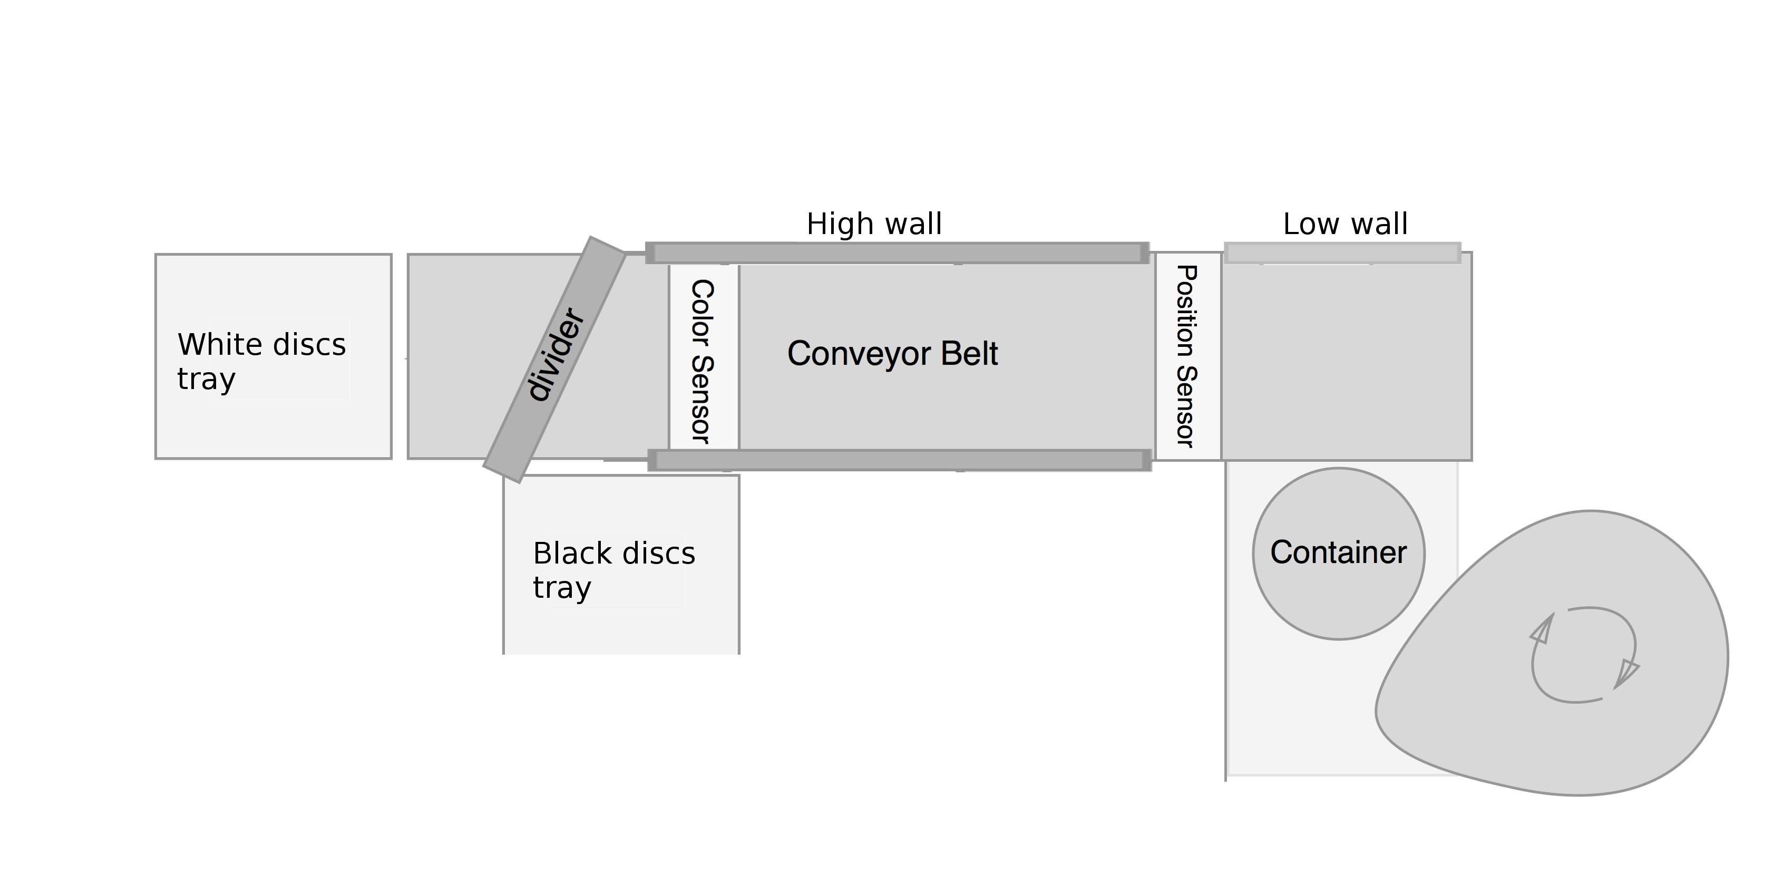
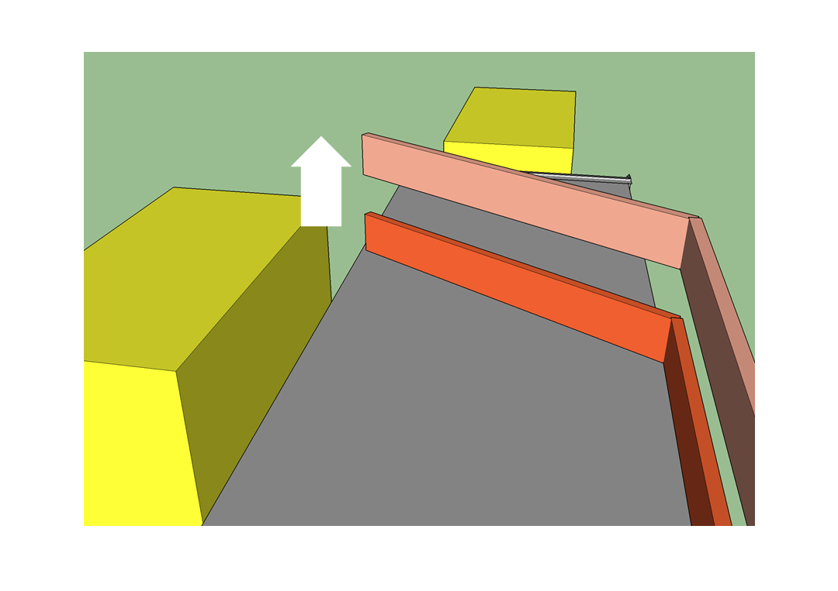
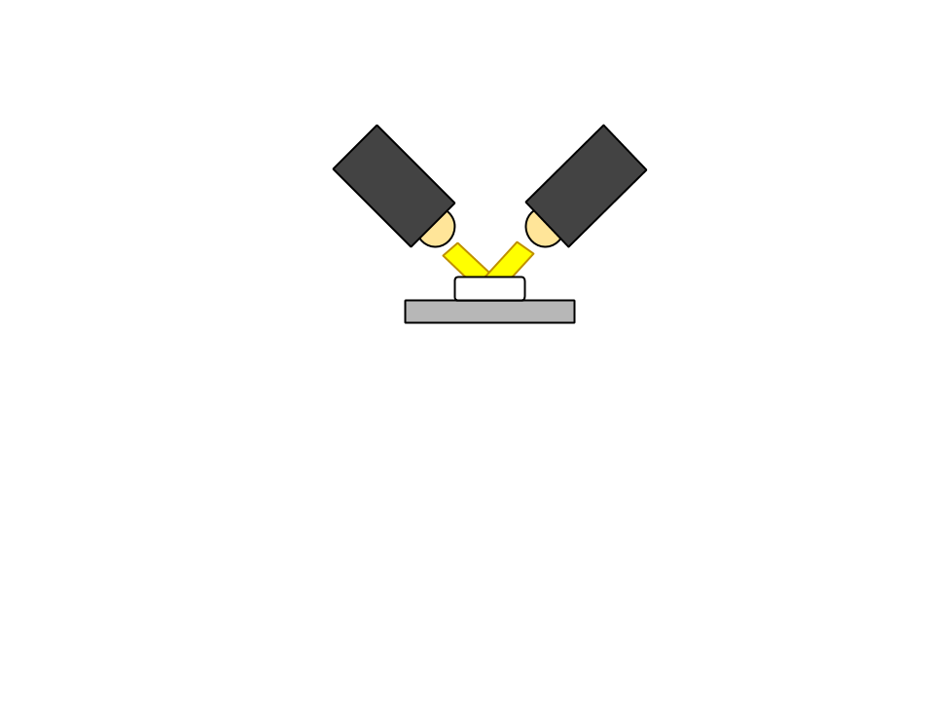
Design Decions
Notes:
tube:
reliable
easily fall
fast
Time between discs
cam
Tilt
Angle
sorter
floor space
faster

Slide 5
Software Specification

Slide 6
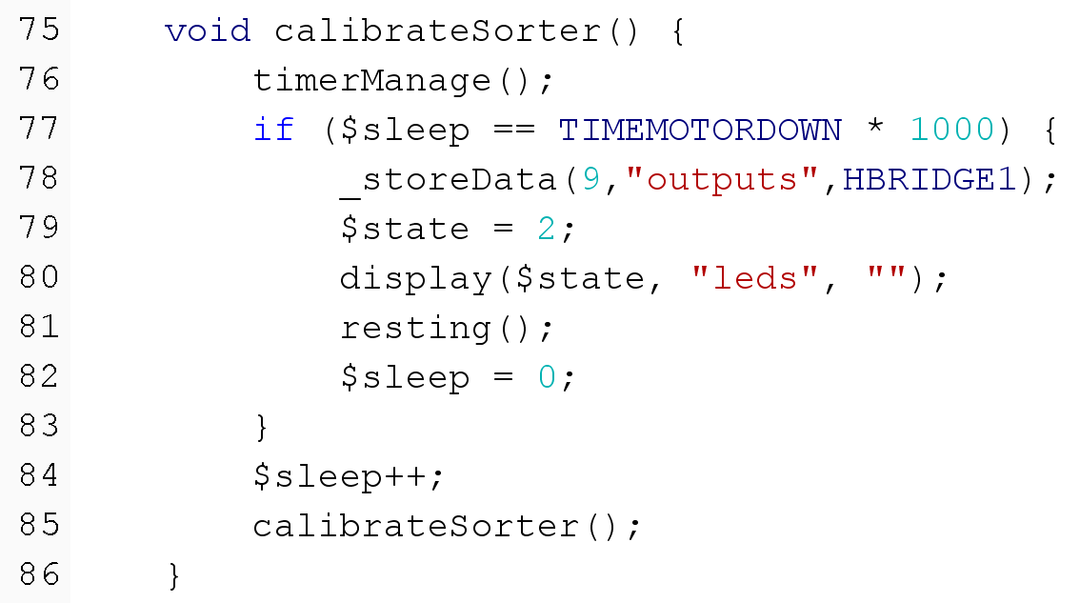
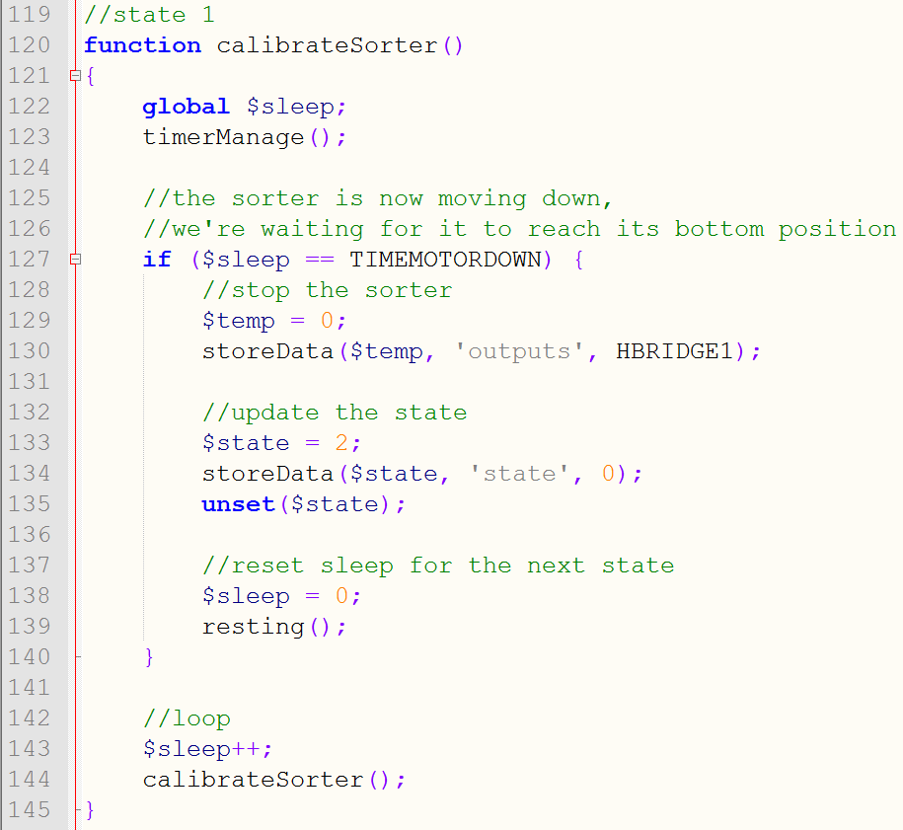
Software Design
Java
PHP

Slide 7
Summary and conclusion
Machine Design is done
Machine consists of three parts
Design decisions and design decisions
PHP to Assembly compiler
Validated

